Slide 1
ACT for Chronic Pain
Delivering Effective Multidisciplinary
Treatment to Any Community
Joel Guarna, Ph.D.
Stephen Hull, M.D.

Slide 2
Living Life Well
Multidisciplinary, Group Based,
Pain Rehabilitation Program
Evolution

Slide 3
Multidisciplinary Pain Rehabilitation
Clinically effective and Cost Effective
Site visits
Mayo Clinic, Rochester, Minnesota
Cleveland Clinic, Cleveland, Ohio
Dartmouth-Hitchcock Medical Center, Lebanon, New Hampshire
Bath Centre for Pain Services, Bath, England, UK

Slide 4
Feasibility Assessment
Population demographics
Predominantly disabled
Payors
Medicaid (MaineCare)
Medicare and Medicare Disability
Charity Care
Commercial Insurance
Disability and Workers Compensation
Staffing

Slide 5
Treatment Team
Physician - Physiatrist, Algiatrist
Physical Therapy Assistant
Psychologist
Clerical Support - Coordinator
Scalable to Any Community
of Pain Patients

Slide 6
Treatment Team
Physician - Interested Physician
Exercise Director
Behavioral Therapist
Clerical Support - Coordinator
Appropriate Space (CBT and Exercise)
Scalable to Any Community
of Pain Patients

Slide 7
Exclusion (Admission) Criteria
Medical and Psychological

Slide 8
Exclusion (Admission) Criteria
Non-Acute (Chronic) Pain
Reasonable symptom reduction options
Medical contraindications to exercise
Significant cognitive impairment
Inability to work in a group
Social phobia or agoraphobia
History of disruptive behavior
VERY severe depression
Language, geographic, and financial limitations

Slide 9
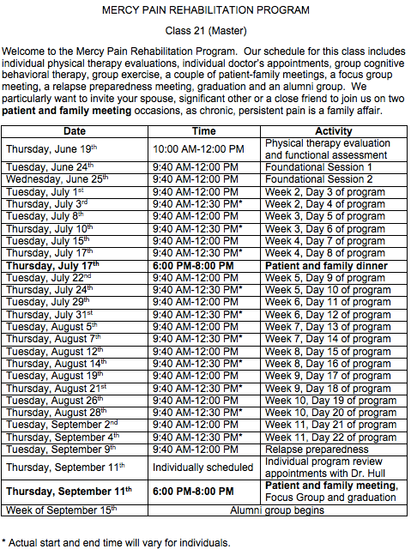
NEGATIVE SELLING

Slide 11
Gotta Have a Margin
Psychologist - Bills a group therapy charge
Physician - Bills an office visit charge
Physical Therapy Assistant - no charge
Break even is at 3 paying patients
Cost is $5,000 - $7,000

Slide 12
Foundational Day 1
Our Point of View

Slide 13
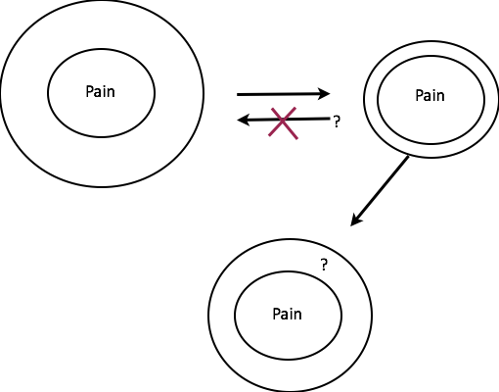

Slide 14
Outside
(5 senses)
Away
Toward
Me noticing
Body
Emotions
Thinking
Pain
Anxious
Irritable
Annoyed
Angry
“I can’t...”
“Why?”
“I used to...”
“Nothing will ever
change.”
Sharp
Radiating
Tension
Spasms
Depressed
Hopeless
Guilty
Self-judgments
Distraction
Attention
Memory
HR up
Breathing
Fatigue
Inside
(mental)

Slide 15
Outside
(5 senses)
Away
Toward
Me noticing
Body
Emotions
Thinking
Pain
Anxious
Irritable
Annoyed
Angry
“I can’t...”
“Why?”
“I used to...”
“Nothing will ever
change.”
Sharp
Radiating
Tension
Spasms
Depressed
Hopeless
Guilty
Self-judgments
Distraction
Attention
Memory
HR up
Breathing
Fatigue
Inside
(mental)

Slide 16
Outside
(5 senses)
Drink
Street drugs
Compulsive
behaviors
Avoid
Isolate
Hide
Sleep
Take meds
Call dr.
Distraction
Stretch
Call a friend
Go for a walk
Yoga
Breathing exercises
Away
Toward
Me noticing
Body
Emotions
Thinking
Pain
Anxious
Irritable
Annoyed
Angry
“I can’t...”
“Why?”
“I used to...”
“Nothing will ever
change.”
Sharp
Radiating
Tension
Spasms
Depressed
Hopeless
Guilty
Self-judgments
Distraction
Attention
Memory
HR up
Breathing
Fatigue
Inside
(mental)

Slide 17
Outside
(5 senses)
Drink
Street drugs
Compulsive
behaviors
Avoid
Isolate
Hide
Sleep
Take meds
Call dr.
Distraction
Stretch
Call a friend
Go for a walk
Yoga
Breathing exercises
Away
Toward
Me noticing
Body
Emotions
Thinking
Pain
Anxious
Irritable
Annoyed
Angry
“I can’t...”
“Why?”
“I used to...”
“Nothing will ever
change.”
Relns
Resp
Rec
Health
Loving
Warm
Supportive
Close
Caring
Fun
Honest
Caretaker
Supportive
Responsible
Job
Dependable
Productive
Self?
Quilting
Fishing
Hiking
Watching
Sports
Walking
Movement
Strong
Sharp
Radiating
Kids
Spouse
Friend
Tension
Spasms
Depressed
Hopeless
Guilty
Self-judgments
Distraction
Attention
Memory
HR up
Breathing
Fatigue
Inside
(mental)

Slide 18
Outside
(5 senses)
Drink
Street drugs
Compulsive
behaviors
Avoid
Isolate
Hide
Sleep
Take meds
Call dr.
Distraction
Stretch
Call a friend
Go for a walk
Yoga
Breathing exercises
Away
Toward
Me noticing
Body
Emotions
Thinking
Pain
Anxious
Irritable
Annoyed
Angry
“I can’t...”
“Why?”
“I used to...”
“Nothing will ever
change.”
Relns
Resp
Rec
Health
Loving
Warm
Supportive
Close
Caring
Fun
Honest
Caretaker
Supportive
Responsible
Job
Dependable
Productive
Self?
Quilting
Fishing
Hiking
Watching
Sports
Walking
Movement
Strong
Sharp
Radiating
Kids
Spouse
Friend
Tension
Spasms
Depressed
Hopeless
Guilty
Self-judgments
Distraction
Attention
Memory
HR up
Breathing
Fatigue
Inside
(mental)

Slide 19
Outside
(5 senses)
Drink
Street drugs
Compulsive
behaviors
Avoid
Isolate
Hide
Sleep
Take meds
Call dr.
Distraction
Stretch
Call a friend
Go for a walk
Yoga
Breathing exercises
Away
Toward
Me noticing
Body
Emotions
Thinking
Pain
Anxious
Irritable
Annoyed
Angry
“I can’t...”
“Why?”
“I used to...”
“Nothing will ever
change.”
Relns
Resp
Rec
Health
Loving
Warm
Supportive
Close
Caring
Fun
Honest
Caretaker
Supportive
Responsible
Job
Dependable
Productive
Self?
Quilting
Fishing
Hiking
Watching
Sports
Walking
Movement
Strong
Sharp
Radiating
Kids
Spouse
Friend
Tension
Spasms
Depressed
Hopeless
Guilty
Self-judgments
Distraction
Attention
Memory
HR up
Breathing
Fatigue
Inside
(mental)

Slide 20
Outside
(5 senses)
Drink
Street drugs
Compulsive
behaviors
Avoid
Isolate
Hide
Sleep
Take meds
Call dr.
Distraction
Stretch
Call a friend
Go for a walk
Yoga
Breathing exercises
Away
Toward
Me noticing
Body
Emotions
Thinking
Pain
Anxious
Irritable
Annoyed
Angry
“I can’t...”
“Why?”
“I used to...”
“Nothing will ever
change.”
Relns
Resp
Rec
Health
Loving
Warm
Supportive
Close
Caring
Fun
Honest
Caretaker
Supportive
Responsible
Job
Dependable
Productive
Self?
Quilting
Fishing
Hiking
Watching
Sports
Walking
Movement
Strong
Sharp
Radiating
Kids
Spouse
Friend
Tension
Spasms
Depressed
Hopeless
Guilty
Self-judgments
Distraction
Attention
Memory
HR up
Breathing
Fatigue
Inside
(mental)

Slide 21
Outside
(5 senses)
Drink
Street drugs
Compulsive
behaviors
Avoid
Isolate
Hide
Sleep
Take meds
Call dr.
Distraction
Stretch
Call a friend
Go for a walk
Yoga
Breathing exercises
Away
Toward
Me noticing
Body
Emotions
Thinking
Pain
Anxious
Irritable
Annoyed
Angry
“I can’t...”
“Why?”
“I used to...”
“Nothing will ever
change.”
Relns
Resp
Rec
Health
Loving
Warm
Supportive
Close
Caring
Fun
Honest
Caretaker
Supportive
Responsible
Job
Dependable
Productive
Self?
Quilting
Fishing
Hiking
Watching
Sports
Walking
Movement
Strong
Sharp
Radiating
Kids
Spouse
Friend
Tension
Spasms
Depressed
Hopeless
Guilty
Self-judgments
Distraction
Attention
Memory
HR up
Breathing
Fatigue
Inside
(mental)

Slide 22
Outside
(5 senses)
Drink
Street drugs
Compulsive
behaviors
Avoid
Isolate
Hide
Sleep
Take meds
Call dr.
Distraction
Stretch
Call a friend
Go for a walk
Yoga
Breathing exercises
Away
Toward
Me noticing
Body
Emotions
Thinking
Pain
Anxious
Irritable
Annoyed
Angry
“I can’t...”
“Why?”
“I used to...”
“Nothing will ever
change.”
Relns
Resp
Rec
Health
Loving
Warm
Supportive
Close
Caring
Fun
Honest
Caretaker
Supportive
Responsible
Job
Dependable
Productive
Self?
Quilting
Fishing
Hiking
Watching
Sports
Walking
Movement
Strong
Sharp
Radiating
Kids
Spouse
Friend
Tension
Spasms
Depressed
Hopeless
Guilty
Self-judgments
Distraction
Attention
Memory
HR up
Breathing
Fatigue
Inside
(mental)

Slide 23
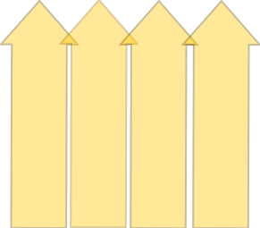
Outside
(5 senses)
Drink
Street drugs
Compulsive
behaviors
Avoid
Isolate
Hide
Sleep
Take meds
Call dr.
Distraction
Stretch
Call a friend
Go for a walk
Yoga
Breathing exercises
Away
Toward
Me noticing
Body
Emotions
Thinking
Pain
Anxious
Irritable
Annoyed
Angry
“I can’t...”
“Why?”
“I used to...”
“Nothing will ever
change.”
Relns
Resp
Rec
Health
Loving
Warm
Supportive
Close
Caring
Fun
Honest
Caretaker
Supportive
Responsible
Job
Dependable
Productive
Self?
Quilting
Fishing
Hiking
Watching
Sports
Walking
Movement
Strong
Sharp
Radiating
Kids
Spouse
Friend
Tension
Spasms
Depressed
Hopeless
Guilty
Self-judgments
Distraction
Attention
Memory
HR up
Breathing
Fatigue
Inside
(mental)

Slide 24
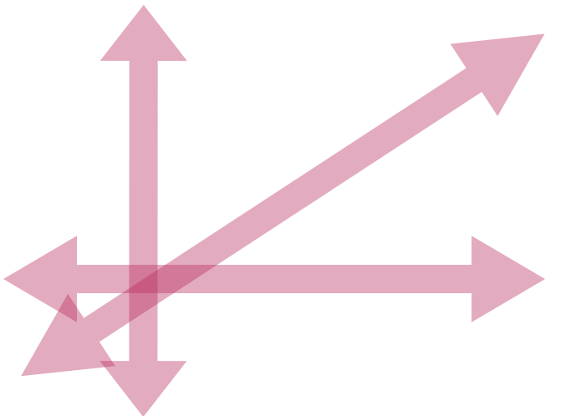
Outside
(5 senses)
Drink
Street drugs
Compulsive
behaviors
Avoid
Isolate
Hide
Sleep
Take meds
Call dr.
Distraction
Stretch
Call a friend
Go for a walk
Yoga
Breathing exercises
Away
Toward
Me noticing
Body
Emotions
Thinking
Pain
Anxious
Irritable
Annoyed
Angry
“I can’t...”
“Why?”
“I used to...”
“Nothing will ever
change.”
Relns
Resp
Rec
Health
Loving
Warm
Supportive
Close
Caring
Fun
Honest
Caretaker
Supportive
Responsible
Job
Dependable
Productive
Self?
Quilting
Fishing
Hiking
Watching
Sports
Walking
Movement
Strong
Sharp
Radiating
Kids
Spouse
Friend
Tension
Spasms
Depressed
Hopeless
Guilty
Self-judgments
Distraction
Attention
Memory
HR up
Breathing
Fatigue
Inside
(mental)

Slide 25
Foundational Day 2
Neuro-physiology
(Structure-Function)

Slide 27
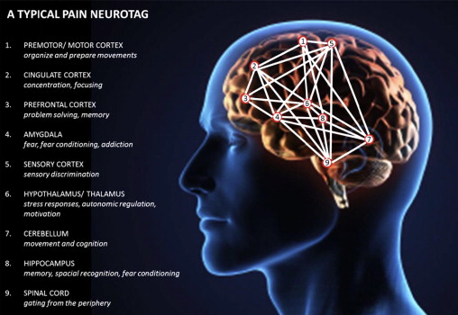

Slide 28
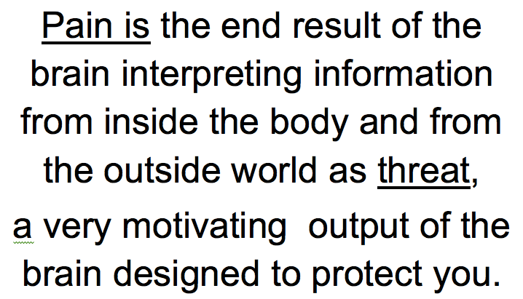

Slide 29
Outside
(5 senses)
Drink
Street drugs
Compulsive
behaviors
Avoid
Isolate
Hide
Sleep
Away
Toward
Me noticing
Body
Emotions
Thinking
Pain
Anxious
Irritable
Annoyed
Angry
“I can’t...”
“Why?”
“I used to...”
“Nothing will ever
change.”
Sharp
Radiating
Tension
Spasms
Depressed
Hopeless
Guilty
Self-judgments
Distraction
Attention
Memory
HR up
Breathing
Fatigue
Inside
(mental)

Slide 30
Outside
(5 senses)
Drink
Street drugs
Compulsive
behaviors
Avoid
Isolate
Hide
Sleep
Take meds
Call dr.
Distraction
Stretch
Call a friend
Go for a walk
Yoga
Breathing exercises
What for?
Away
Toward
Me noticing
Body
Emotions
Thinking
Pain
Anxious
Irritable
Annoyed
Angry
“I can’t...”
“Why?”
“I used to...”
“Nothing will ever
change.”
Sharp
Radiating
Tension
Spasms
Depressed
Hopeless
Guilty
Self-judgments
Distraction
Attention
Memory
HR up
Breathing
Fatigue
Inside
(mental)

Slide 31
Outside
(5 senses)
Away
Toward
Me noticing
Body
Emotions
Thinking
Pain
Anxious
“I can’t...”
Tension
Angry
Fatigue
Attention
Depressed
“Why?”
Guilty
Inside
(mental)

Slide 32
Outside
(5 senses)
Take meds
Call dr.
Distraction
Brief Committed Actions
(BCAs)
Away
Toward
Me noticing
Body
Emotions
Thinking
Relns
Resp
Rec
Health
Loving
Warm
Supportive
Close
Caring
Fun
Honest
Caretaker
Supportive
Responsible
Job
Dependable
Productive
Self?
Quilting
Fishing
Hiking
Watching
Sports
Walking
Movement
Strong
Kids
Spouse
Friend
Inside
(mental)

Slide 33
Outside
(5 senses)
Take meds
Call dr.
Distraction
Stretch
Call a friend
Go for a walk
Yoga
Breathing exercises
Mindfulness
Mindful Activities
Away
Toward
Me noticing
Body
Emotions
Thinking
Relns
Resp
Rec
Health
Loving
Warm
Supportive
Close
Caring
Fun
Honest
Caretaker
Supportive
Responsible
Job
Dependable
Productive
Self?
Quilting
Fishing
Hiking
Watching
Sports
Walking
Movement
Strong
Kids
Spouse
Friend
Inside
(mental)

Slide 34
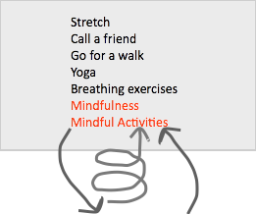
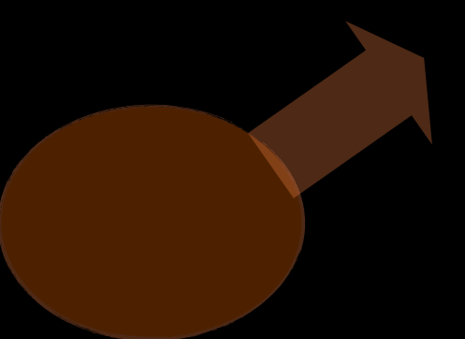
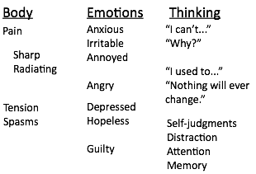
Outside
(5 senses)
Take meds
Call dr.
Distraction
Away
Toward
Me noticing
Body
Emotions
Thinking
Relns
Resp
Rec
Health
Loving
Warm
Supportive
Close
Caring
Fun
Honest
Caretaker
Supportive
Responsible
Job
Dependable
Productive
Self?
Quilting
Fishing
Hiking
Watching
Sports
Walking
Movement
Strong
Kids
Spouse
Friend
Inside
(mental)

Slide 35
Hooligans on the Bus

Slide 36
Outside
(5 senses)
Relapse Preparedness
Away
Toward
Me noticing
Warning Signs
Inside
(mental)

Slide 37
Outcomes

Slide 38
Outcome
Physical Measures
Affective Measures
PHQ-9
GAD-7
Functional Measures
Chronic Pain Acceptance Questionnaire (CPAQ)
Treatment Outcomes of Pain Survey, Short (S-TOPS)
Medical Outcomes Study Sleep Scale
Oswestry Disability Index
Neck Disability Index

Slide 39
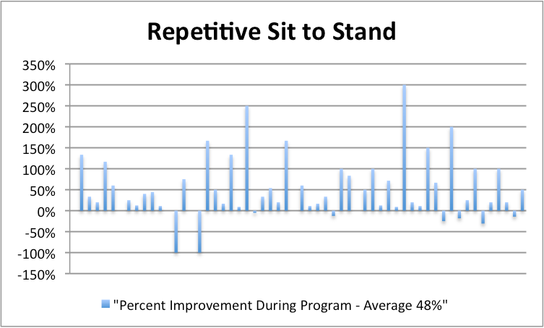

Slide 40
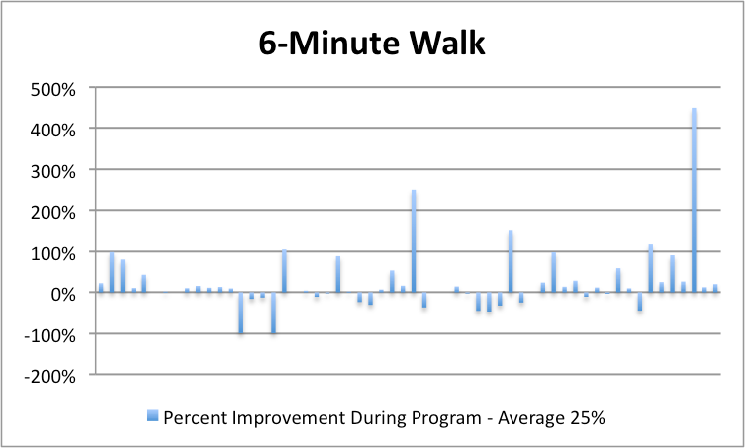

Slide 41
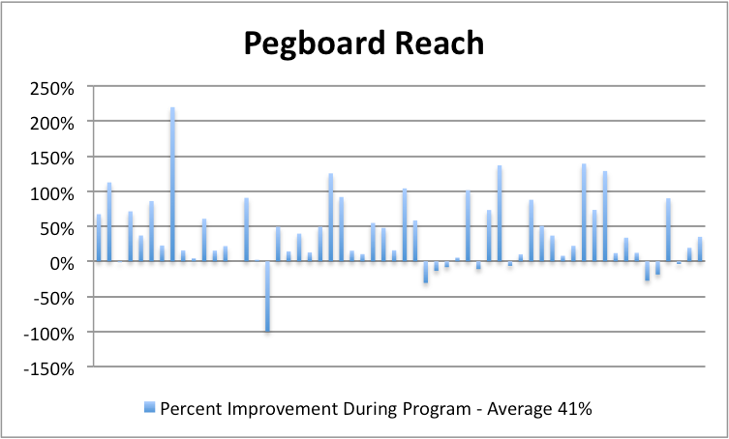

Slide 42
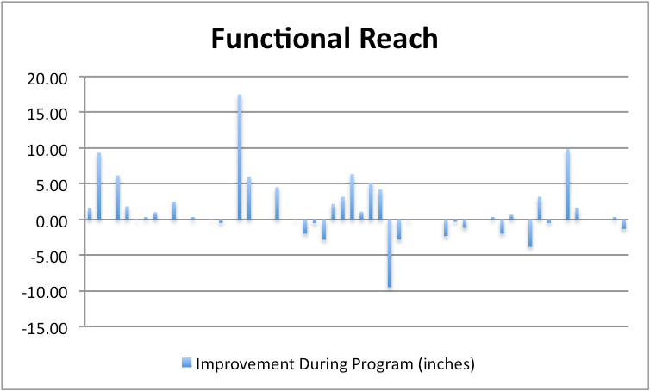

Slide 43
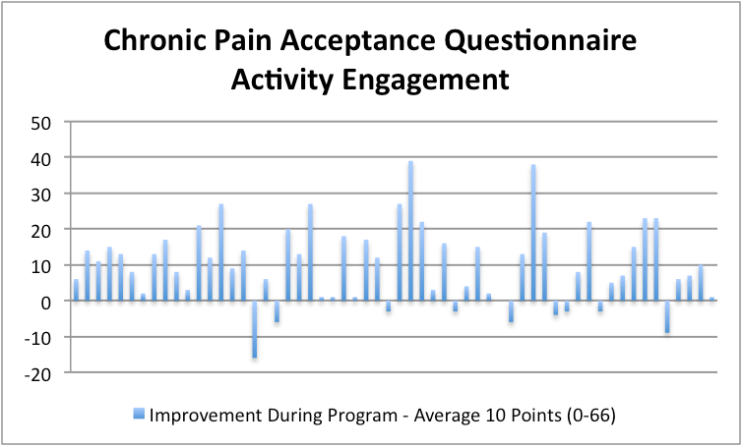
Average score on admission 28.5

Slide 44
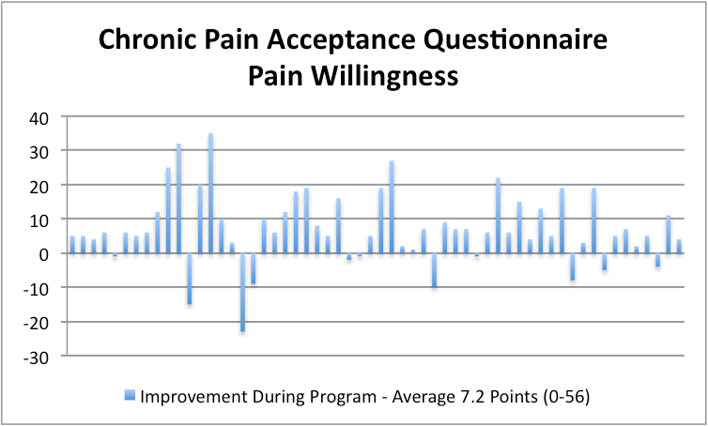
Average score on admission 17.7

Slide 45
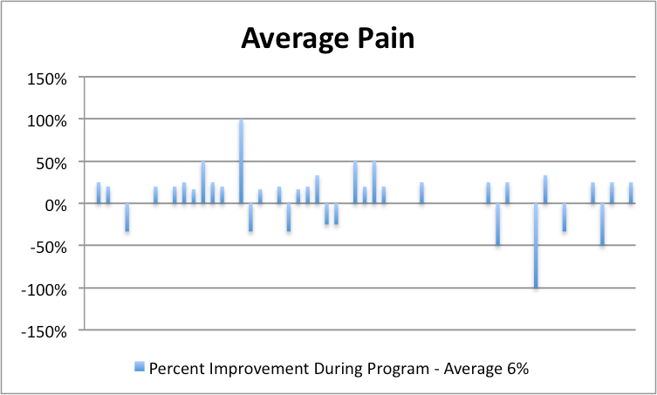

Slide 46
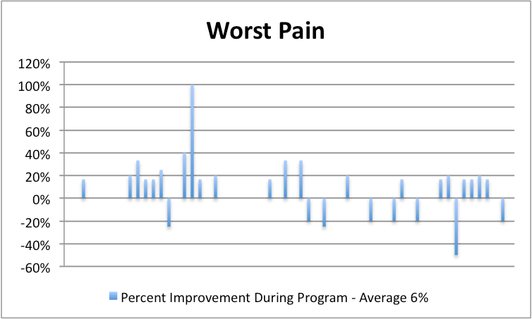

Slide 47
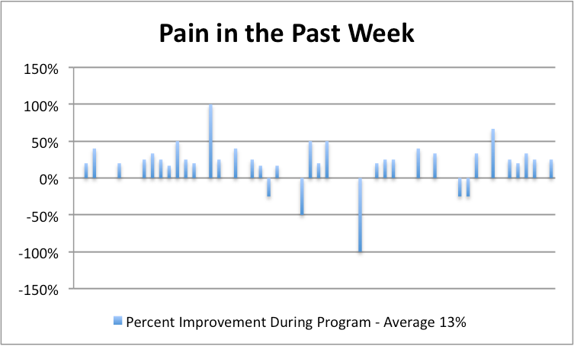

Slide 48
Mindfulness Resources
Websites: www.sittingtogether.com
www.ayearofbeinghere.com
Neurophysiology Resources
Book: Explain Pain by David Butler and Lorimer Moseley
Blog: http://explainpain.blogspot.com
Listserve: http://www.bodyinmind.org
YouTube Video:
Lorimer Moseley TED Talk
https://www.youtube.com/watch?v=gwd-wLdIHjs
Understanding Pain: What to do about it in less than 5 minutes
https://www.youtube.com/watch?v=4b8oB757DKc

Slide 49
joel.whitepine@gmail.com hulls@emhs.org

